Slide 1
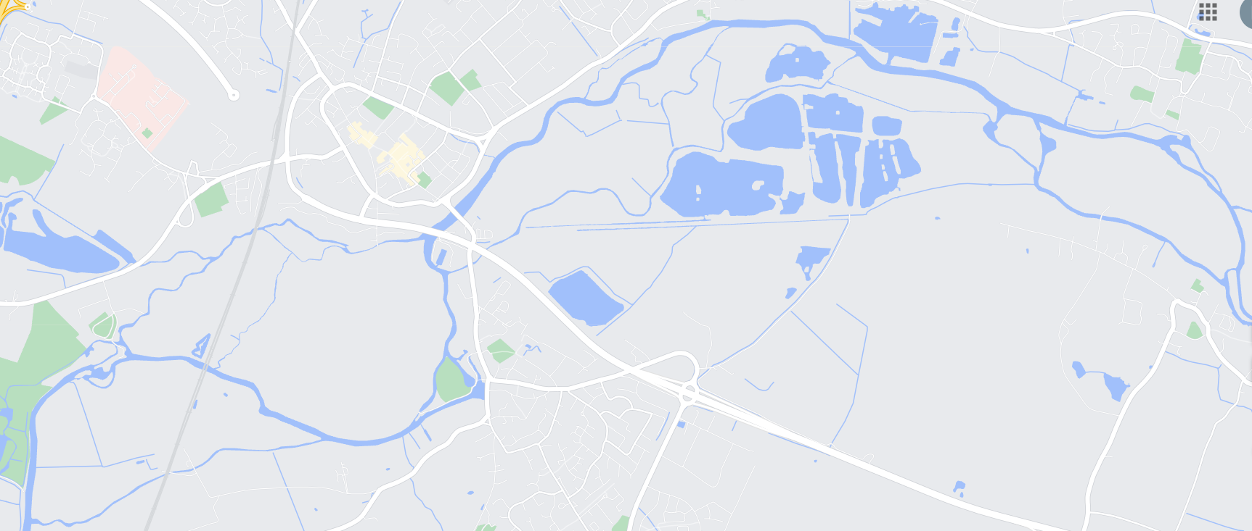
Millside Canoe Hire – 07952 642956
The Three Jolly Butchers
Godmanchester Nature Reserve
The Old Bridge
Hotel
Cooks Backwater
Brampton Mill
Godmanchester
Lock
X
Brampton Lock
Leas Brooke
River Great Ouse

